Slide 1
List, Set, and Map

Slide 2
List, Set, and Map
Working with a group of related values is an essential part of many programs. For example, your program might manage lists of books, travel destinations, menu items, or tavern patron check balances. Collections allow you to conveniently work with those groups of values and pass them as arguments to functions.
You will see the most commonly used collection types in the next two chapters: List, Set, and Map.

Slide 3
Lists
Lists hold an ordered collection of values and allow duplicate values.
listOf returns a read-only list (more on that shortly) populated with the elements you provide for the argument. Create your list with three patron names:
import kotlin.math.roundToInt
const val TAVERN_NAME = "Taernyl's Folly"
var playerGold = 10
var playerSilver = 10
val patronList: List<String> = listOf("Eli", "Mordoc", "Sophie")
fun main(args: Array<String>) {
placeOrder("shandy,Dragon's Breath,5.91")
println(patronList)
}
...

Slide 4
Up to now, you have been creating variables of various types by simply declaring them. But collections require two steps: creating the collection (here, the list to hold the patrons) and adding contents to it (the patron names). Kotlin provides functions, like listOf, that do both at once.
Now that you have a list, let’s take a closer look at the List type. Though type inference does work with lists, you included the type information – val patronList: List<String> – to make it visible for discussion. Notice the diamond braces in List<String>. <String> is known as a parameterized type, and it tells the compiler about the type that the contents of the list will be – in this case, Strings. Changing the type parameter changes what the compiler allows the list to hold.
...
var patronList: List<String> = listOf("Eli", "Mordoc", "Sophie", 1)
...
IntelliJ warns you that the integer does not conform to the expected type, String. Type parameters are used with List because List is a generic type. This means that a list can hold any type of data, including textual data like strings (as in the case of patronList) or characters, numeric data like integers or doubles, or even a new type that you define.

Slide 5
Accessing a list’s elements
You can access any element of a list using the element’s index and the [] operator. Lists are zero-indexed, so "Eli" is at index 0, and "Sophie" is at index 2.
import kotlin.math.roundToInt
const val TAVERN_NAME = "Taernyl's Folly"
var playerGold = 10
var playerSilver = 10
val patronList: List<String> = listOf("Eli", "Mordoc", "Sophie")
fun main(args: Array<String>) {
placeOrder("shandy,Dragon's Breath,5.91")
println(patronList[0])
}
...
List also provides other convenience index access functions, like accessing the first or last element:
patronList.first() // Eli
patronList.last() // Sophie

Slide 6
Index boundaries and safe index access
Accessing an element by index requires care, because attempting to access an element at an index that does not exist – say, the fourth item from a list that contains only three – causes an ArrayIndexOutOfBoundsException exception.
val patronList = listOf("Eli", "Mordoc", "Sophie")
patronList[4]
The result is java.lang.ArrayIndexOutOfBoundsException: 4.
Because accessing an element by an index can throw an exception, Kotlin provides safe index access functions that allow you to deal with the problem differently. Instead of throwing an exception if the index is out of bounds, some other result will occur.
For example, one of these safe index access functions, getOrElse, takes two arguments: The first is the requested index (in parentheses, not square brackets). The second is a lambda that generates a default value, instead of an exception, if the requested index does not exist.
val patronList = listOf("Eli", "Mordoc", "Sophie")
patronList.getOrElse(4) { "Unknown Patron" }
Another safe index access function, getOrNull, returns null instead of throwing an exception. When you use getOrNull, you must decide what to do with the null value. One option is to coalesce the null value to a default.
val fifthPatron = patronList.getOrNull(4) ?: "Unknown Patron"
fifthPatron

Slide 7
Checking the contents of a list
The tavern has dark corners and secret back rooms. Fortunately, the keen-eyed tavern master keeps diligent records of which patrons have left or entered in the patron list. If you ask whether a particular patron is present, the tavern master can tell you by looking at the list.
fun main(args: Array<String>) {
if (patronList.contains("Eli")) {
println("The tavern master says: Eli's in the back playing cards.")
} else {
println("The tavern master says: Eli isn't here.")
}
placeOrder("shandy,Dragon's Breath,5.91")
println(patronList[0])
}

Slide 8
Note that the contains function performs a structural comparison for the elements in the list, like the structural equality operator. You can also use the containsAll function to check whether several patrons are present at once. Update the code to ask the tavern master whether both Sophie and Mordoc are present:
fun main(args: Array<String>) {
if (patronList.contains("Eli")) {
println("The tavern master says: Eli's in the back playing cards. ")
} else {
println("The tavern master says: Eli isn't here.")
}
if (patronList.containsAll(listOf("Sophie", "Mordoc"))) {
println("The tavern master says: Yea, they're seated by the stew kettle.")
} else {
println("The tavern master says: Nay, they departed hours ago.")
}
placeOrder("shandy,Dragon's Breath,5.91")
}

Slide 9
Changing a list’s contents
listOf returns a read-only list that does not allow changes to its contents: You cannot add, remove, update, or replace entries. Readonly lists are a good idea, because they prevent unfortunate mistakes – like kicking a patron out into the cold by accidentally removing them from the list.
The read-only nature of the list has nothing to do with the val or var keyword you used to define the list variable. Changing the variable declaration for patronList from val (as it is defined now) to var would not change the list from read-only to writable. Instead, it would allow you to reassign the patronList variable to hold a new, different list.
List mutability is defined by the type of the list and refers to whether you can modify the elements in the list. Since patrons come and go from the tavern freely, the type of patronList needs to be changed to allow updates. In Kotlin, a modifiable list is known as a mutable list, and you use the mutableListOf function to create one.
val patronList = listOf("Eli", "Mordoc", "Sophie")
val patronList = mutableListOf("Eli", "Mordoc", "Sophie")
fun main(args: Array<String>) {
placeOrder("shandy,Dragon's Breath,5.91")
println(patronList)
patronList.remove("Eli")
patronList.add("Alex")
println(patronList)

Slide 10
List mutability is defined by the type of the list and refers to whether you can modify the elements in the list. When you need to be able to modify the elements in a list, use a MutableList. Otherwise, it is a good idea to restrict mutability by using List.
Note that the new element was added at the end of the list. You can also add a patron at a particular position in the list.
val patronList = mutableListOf("Eli", "Mordoc", "Sophie")
fun main(args: Array<String>) {
...
placeOrder("shandy,Dragon's Breath,5.91")
println(patronList)
patronList.remove("Eli")
patronList.add("Alex")
patronList.add(0, "Alex")
patronList[0] = "Alexis"
println(patronList)
}

Slide 11
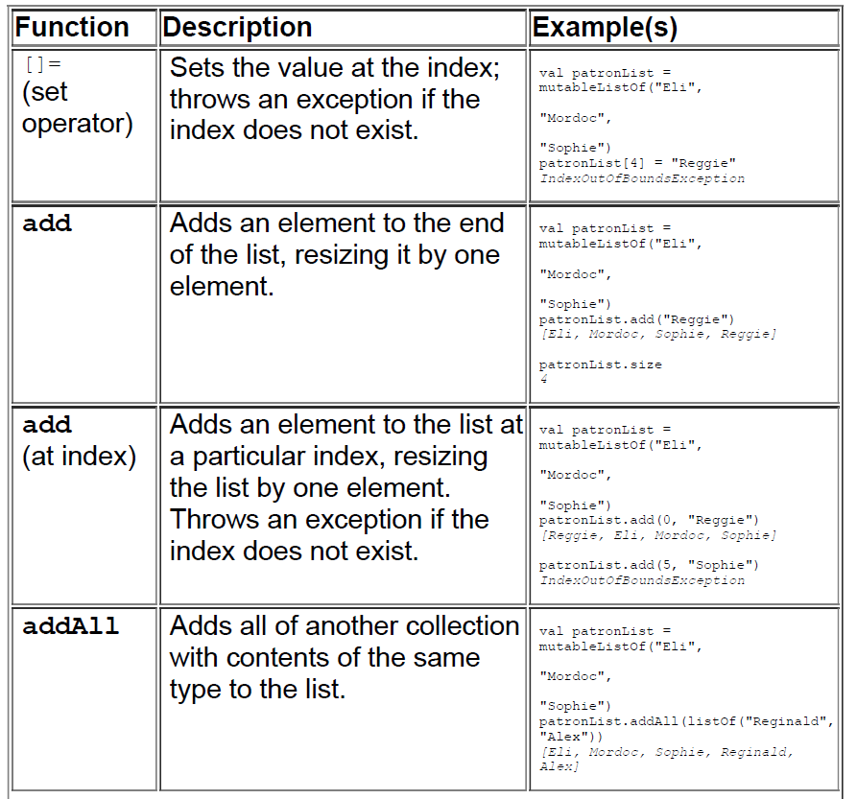
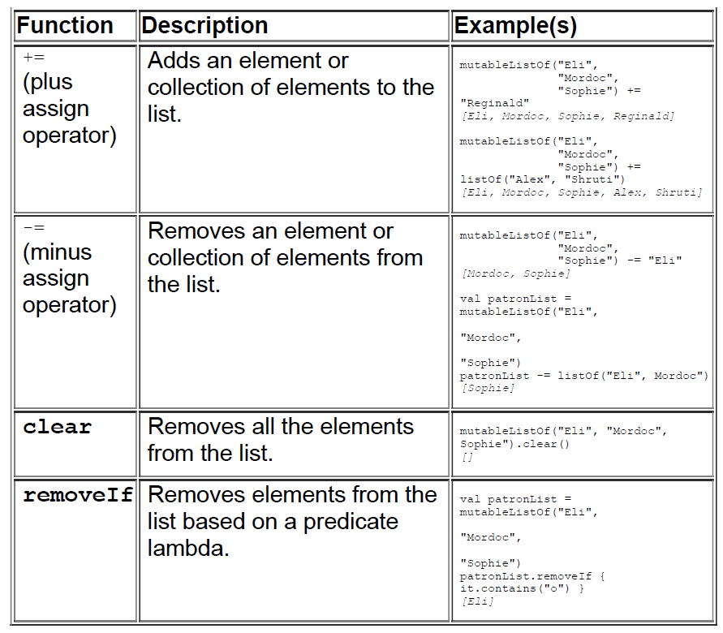

Slide 12
Iteration
Lists include built-in support for a variety of functions that allow you to perform an action for each element of their contents. This concept is called iteration.
One way to iterate through a list is a for loop. Its logic is, “for each element in the list, do something.” You give the element a name, and the Kotlin compiler will automatically detect its type for you.
fun main(args: Array<String>) {
for (patron in patronList) {
println("Good evening, $patron")
}
}

Slide 13
In some languages, Java included, the default for loop syntax requires you to work with indices of the array or collection you are iterating through. This is often cumbersome, but it can be useful. The syntax is verbose and not very readable, but you do get a great
amount of control over how you iterate.
In Kotlin, all for loops rely on iteration to do their work. If you are familiar with Java or C#, this is equivalent to the foreach loops found in those languages.
For those familiar with Java, it can be surprising to find that the common Java expression for(int i = 0; i < 10; i++) { ... } is not possible in Kotlin. Instead, a for loop is written for(i in 1..10) { ... }. However, at the bytecode level, the compiler will optimize a Kotlin for loop to use the Java version, when possible, to improve performance.
Note the in keyword:
for (patron in patronList) { ... }
in specifies the object being iterated over in a for loop. The for loop is simple and readable, but if you prefer a more functional style to your code, then a loop using the forEach function is also an option.
The forEach function traverses each element in the list – one by one, from left to right – and passes each element to the anonymous function you provide as an argument. Replace your for loop with the forEach function.
patronList.forEach { patron ->
println("Good evening, $patron")
}

Slide 14
Kotlin’s for loop and forEach function handle indexing behind the scenes. If you also want access to the index of each element in a list as you iterate, use forEachIndexed. Update Tavern.kt to use forEachIndexed to display each patron’s position in line:
patronList.forEachIndexed { index, patron ->
println("Good evening, $patron - you're #${index + 1} in line.")
}
The forEach and forEachIndexed functions are also available on certain other types in Kotlin. This category of types is called Iterable, and List, Set, Map, IntRange (ranges like 0..9), and other collection types belong to the Iterable category. An iterable supports iteration – in other words, it allows traversing the elements it holds, performing some action for each element.

Slide 15
Sets
Lists, as you have seen, allow duplicate elements (and are ordered, so duplicates – and other elements – can be identified by their position). But sometimes you want a collection that guarantees that its items are unique. For that, you use a Set.
Sets are like Lists in many ways. They use the same iteration functions, and Set also comes in read-only and mutable flavors.
But there are two major differences between lists and sets: The elements of a set are unique, and a set does not provide index based mutators, because the items in a set are not guaranteed to be in any particular order. (That said, you can still read an element at a particular index, which we will discuss shortly.)

Slide 16
Creating a set
Just as you can create a list using the listOf function, you can create a Set using the setOf function. Try creating a set in the REPL:
val planets = setOf("Mercury", "Venus", "Earth")
planets
["Mercury", "Venus", "Earth"]
If you try to create the planets set with a duplicate, only one of the
duplicate items will remain in the set:
val planets = setOf("Mercury", "Venus", "Earth", "Earth")
planets
["Mercury", "Venus", "Earth"]
As with a List, you can check whether a set contains a particular element using contains and containsAll. Try the contains function in the REPL:
planets.contains("Earth")
true
planets.contains("Pluto")
false

Slide 17
Set does not index its contents – meaning it provides no built-in [] operator to access elements using an index. However, you can still request an element at a particular index, using functions that use iteration to accomplish the task. Enter the following into the REPL to read the third planet in the set with the elementAt function:
val planets = setOf("Mercury", "Venus", "Earth")
planets.elementAt(2)
Earth
While this works, using index-based access with a set is an order of magnitude slower than index-based access with a list, because of
the way elementAt works under the hood. When you call the elementAt function on the set, the set iterates to the index you provide, one element at a time. This means that for a large set, requesting an element at a high index would be slower than accessing an element by index in a list. For this reason, if you want index-based access, you probably want a List, not a Set.
Also, while Set does have a mutable version (which you will soon see), no mutator functions are available that rely on indices (like List’s add(index, element) function).
Having said that, Set does provide the very useful feature of eliminating duplicate elements. So what is a programmer who wants unique elements and high-performance, index-based access to do? Use both: Create a Set to eliminate duplicates and convert it a to a List when index-based access or mutator functions are needed.
This is exactly what you will do to develop a more elaborate patronname list for your tavern simulation.

Slide 18
while Loops
for loops are a useful form of control flow when you want to run some code for each element in series. But they are not as good at representing state that cannot be iterated through. That is where while loops are useful.
A while loop’s logic is, “While some condition is true, execute the code in this block.” You are going to generate exactly 10 orders by using a var to keep track of how many orders have been generated and a while loop to continue generating orders until 10 have been placed.
The break Expression
One way to exit a while loop is by changing the state it depends on. Another way to break out of a loop is the break expression.

Slide 19
Collection Conversion
You can also convert a list to a set, or vice versa, using the toSet and toList functions (or their mutable cousins: toMutableSet and toMutableList). A common trick is to call toSet to drop the nonunique elements in a list.
listOf("Eli Baggins", "Eli Baggins", "Eli Ironfoot").toSet()
[Eli Baggins, Eli Ironfoot]
val patrons = listOf("Eli Baggins", "Eli Baggins", "Eli Ironfoot")
.toSet()
.toList()
[Eli Baggins, Eli Ironfoot]
patrons[0]
Eli Baggins
The need to remove duplicates and resume index-based access is so common that Kotlin provides a function on List called distinct that calls toSet and toList internally:
val patrons = listOf("Eli Baggins", "Eli Baggins", "Eli Ironfoot").distinct()
[Eli Baggins, Eli Ironfoot]
patrons[0]
Eli Baggins

Slide 20
Maps
The third commonly used type of collection in Kotlin is Map. The Map type has a lot in common with the List and Set types: All three group a series of elements, are read-only by default, use parameterized types to tell the compiler the type of their contents, and support iteration.
Where Map is different from List and Set is that its elements consist of key-value pairs that you define, and instead of indexbased access using an integer, a map provides key-based access using a type that you specify. Keys are unique and identify the values in the map; the values, on the other hand, do not need to be unique. In this way, Map shares another feature with Set: The keys of a map are guaranteed to be unique, just like the elements of a set.
Like lists and sets, maps are created using functions: mapOf and mutableMapOf.
While the keys in a map must all be of the same type, and the values must be of the same type, the keys and values can be of different types. Here you have a map with string keys and double values. You are using type inference, but if you had wanted to include explicit type information, it would look like this: val patronGold: Map<String, Double>.
You used to to define each entry (key and value) in the map:
mapOf("Eli" to 10.75, "Mordoc" to 8.25, "Sophie" to 5.50)

Slide 21
The to function converts the values on its lefthand and righthand sides into a Pair – a type for representing a group of two elements. Maps are built using key-value Pairs. In fact, another way you could have defined the entries for the map is as follows.
val patronGold = mapOf(Pair("Eli", 10.75),
Pair("Mordoc", 8.00),
Pair("Sophie", 5.50))
However, building a map using the to function is cleaner than this syntax. We have said that the keys in a map must be unique. What if you tried adding a duplicate entry to the map?
val patronGold = mutableMapOf("Eli" to 5.0, "Sophie" to 1.0)
patronGold += "Sophie" to 6.0
println(patronGold)
{Eli=5.0, Sophie=6.0}
You used Map’s plus assign operator (+=) to add a pair with a duplicate key into the map. Since the key "Sophie" was already in the map, the existing pair was replaced with the new one. You see the same behavior if you try to include duplicate keys when initializing a map:
println(mapOf("Eli" to 10.75,
"Mordoc" to 8.25,
"Sophie" to 5.50,
"Sophie" to 6.25))
{Eli=10.5, Mordoc=8.0, Sophie=6.25}

Slide 22
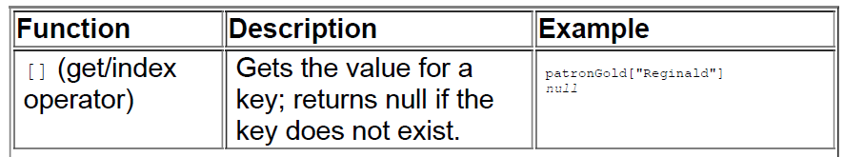
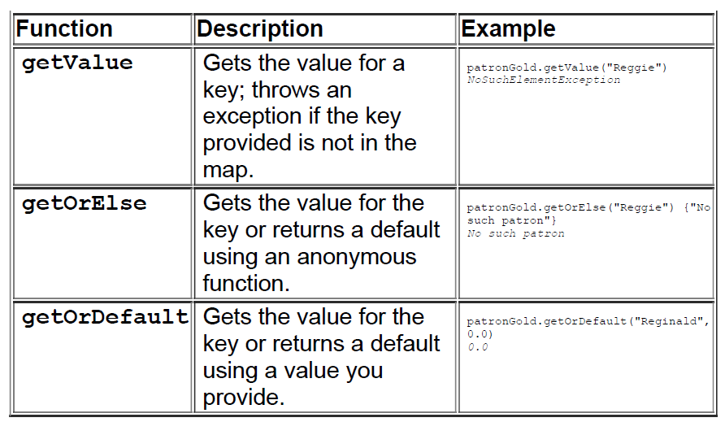
Accessing Map Values
println(patronGold["Eli"])
println(patronGold["Mordoc"])
println(patronGold["Sophie"])

Slide 23
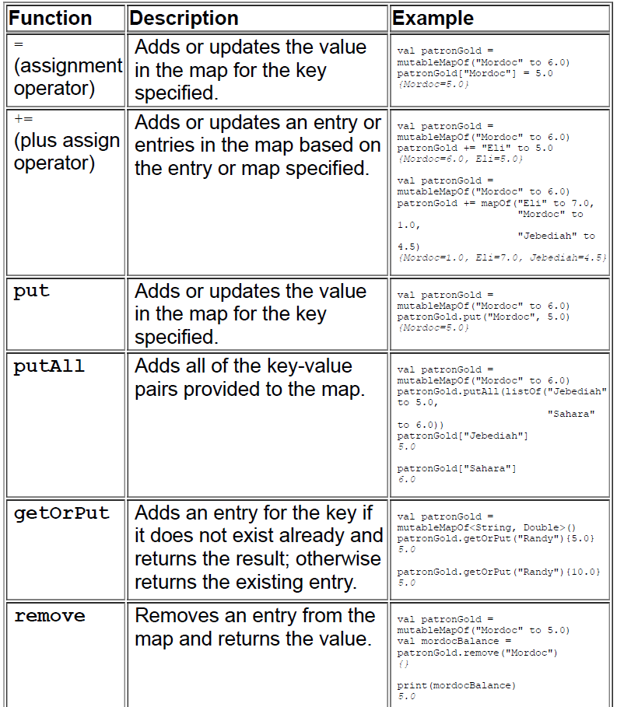
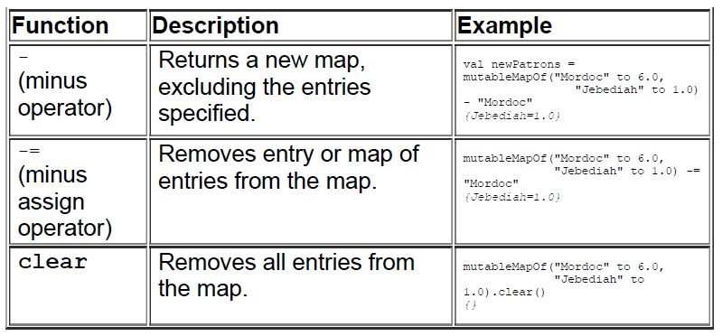
Adding Entries to a Map

Slide 24
